Slide 1


23% of number of patient is increasing every year
Innovative Pressurizer for Engineered-Cartilage
King Mongkut's University of Technology Thonburi
Bangkok, Thailand

Slide 2


Slide 3

23%
and
of number of patient is
increasing
130million
People around the world are affected by
Osteoarthritis

Slide 4

23%
of number of patient
is increasing
each year

Slide 5

Early Stage
Taking Pills
Only ease pain
Continuously taking pills for long period

Slide 6
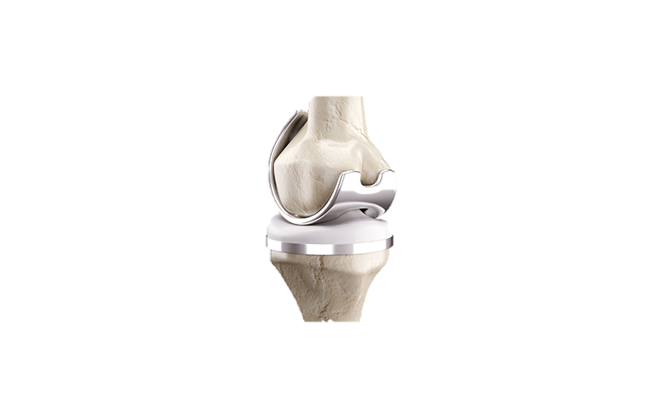
Final Stage
Knee Replacement
Invasive open surgery
Metal implant

Slide 7
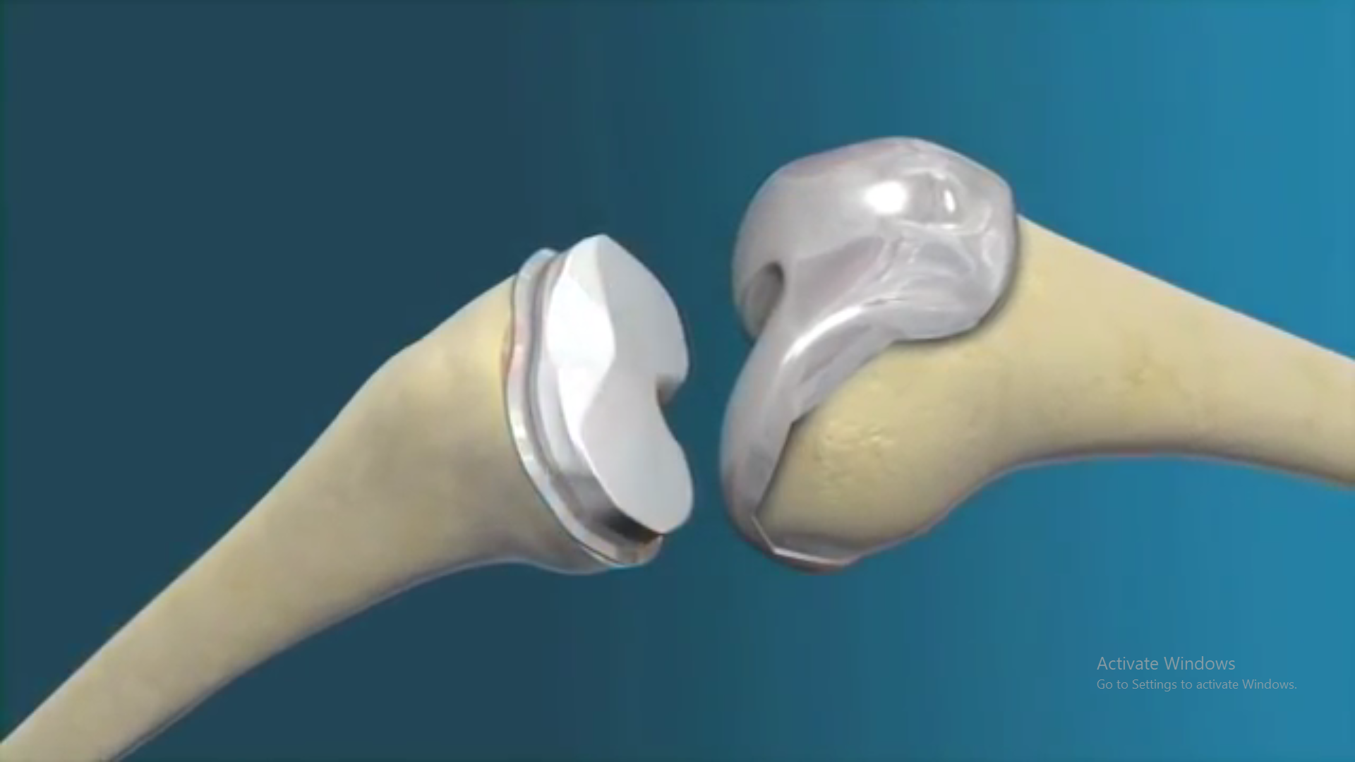
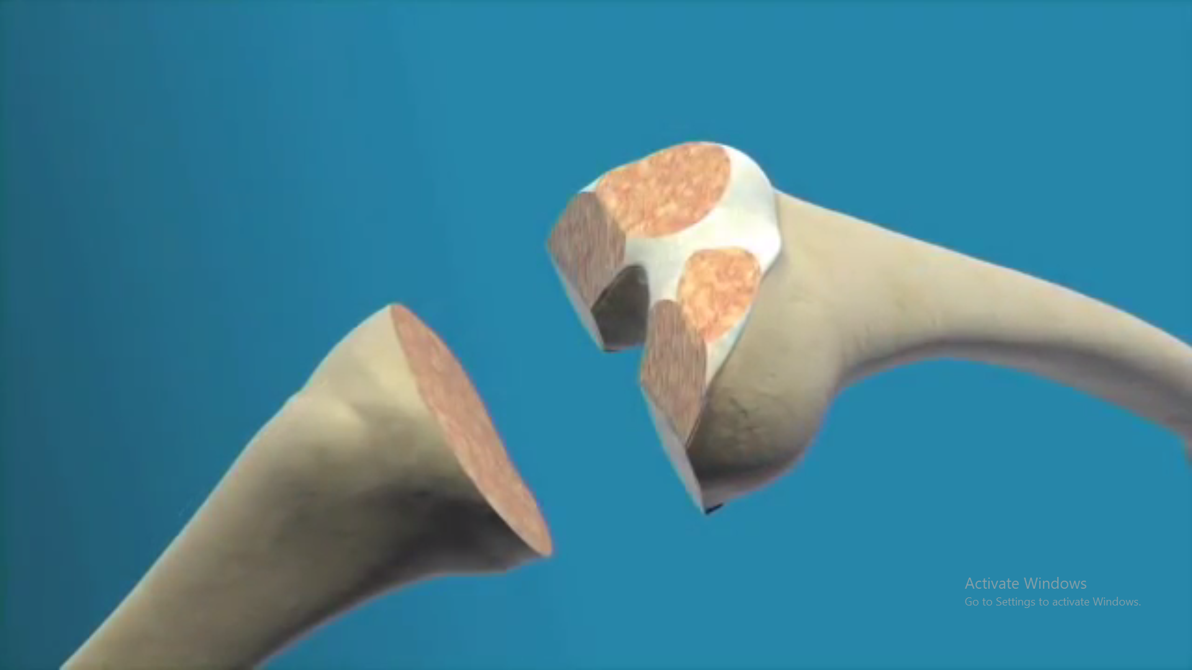
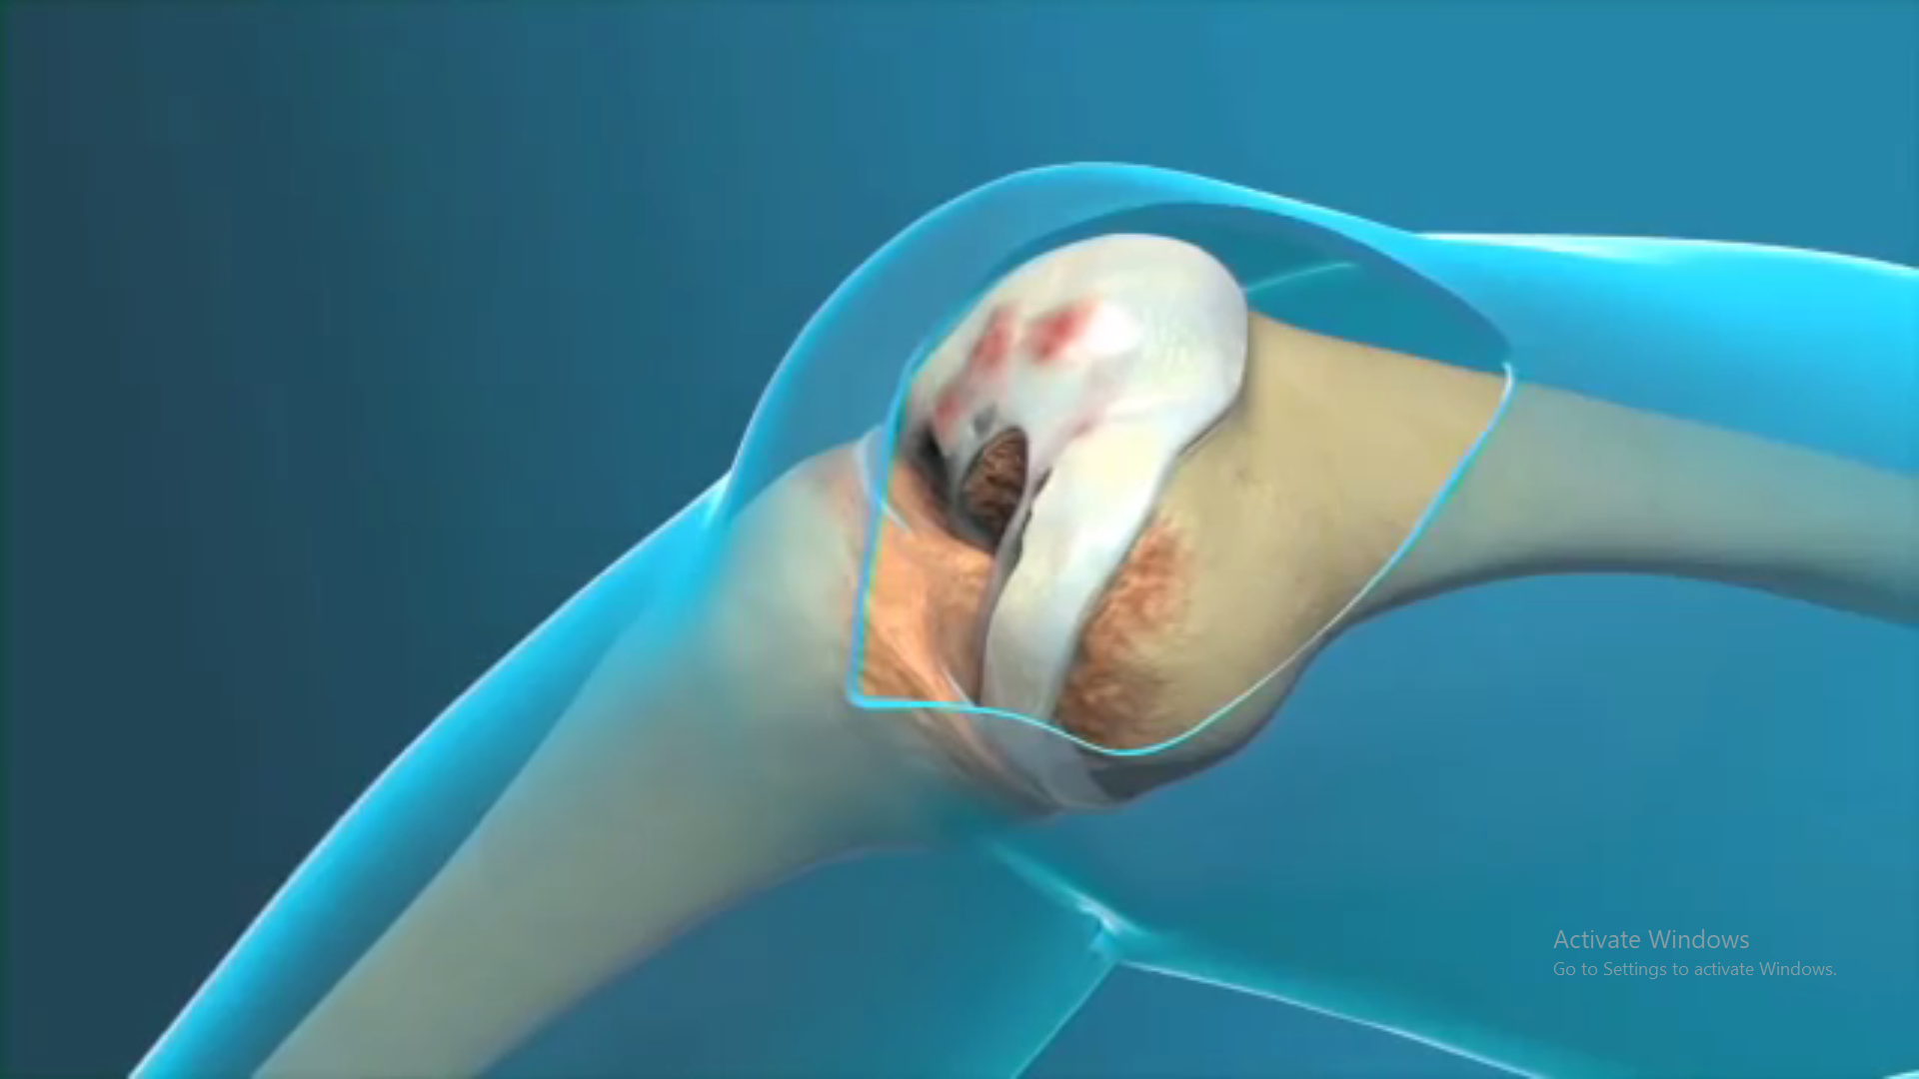

Slide 8
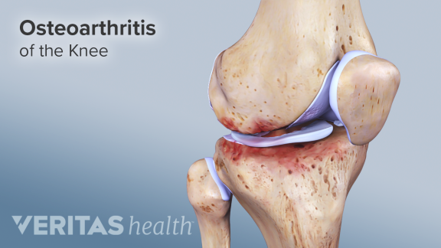
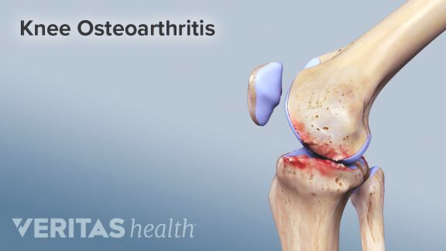
Lack of Cartilage

Slide 9

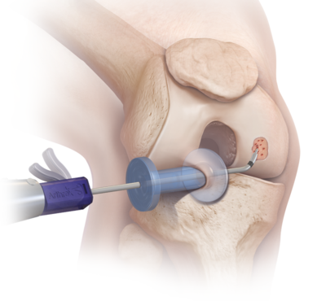
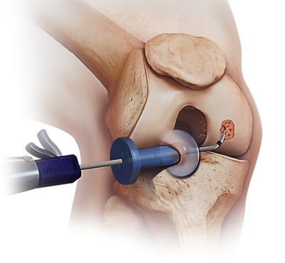
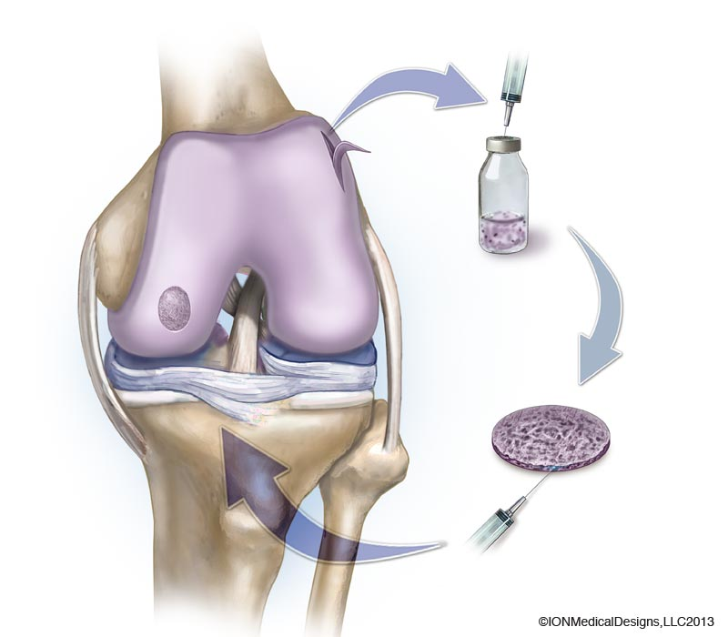

A Device that increases the quality
of cultured cartilage
4
Attach To Patient
3
Creating Tissue
1
Collecting Patient Cell
2
Culturing Cell
2
3
4

Slide 10

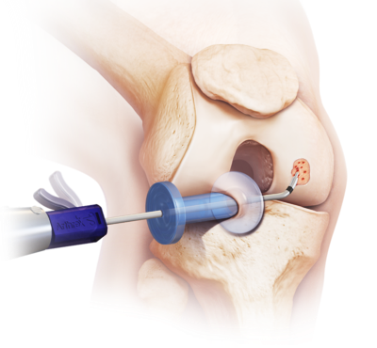
Limitation
Chance of losing cartilage cells
Quality control of cells
A Device that
increases
the quality
of cultured cartilage
2
Culturing Cell

Slide 11
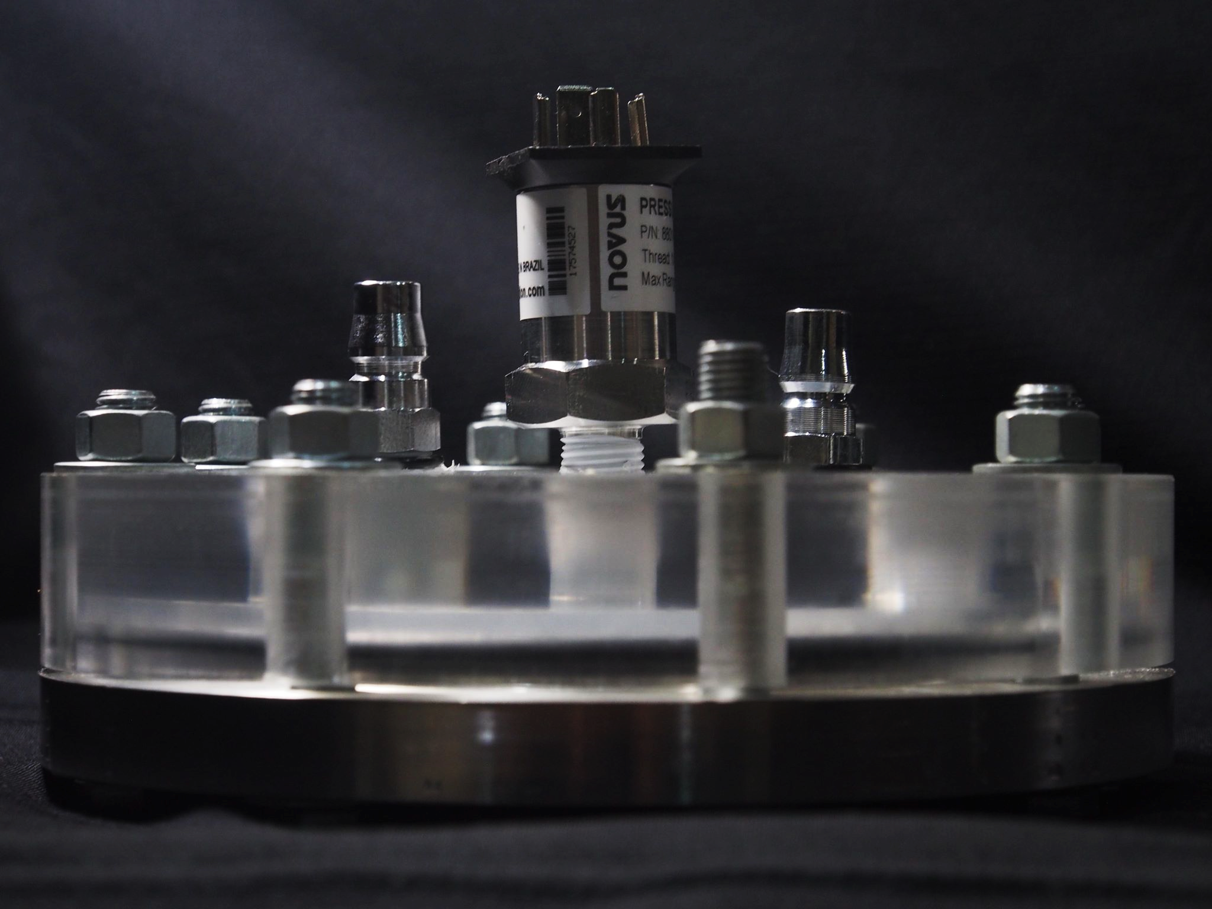
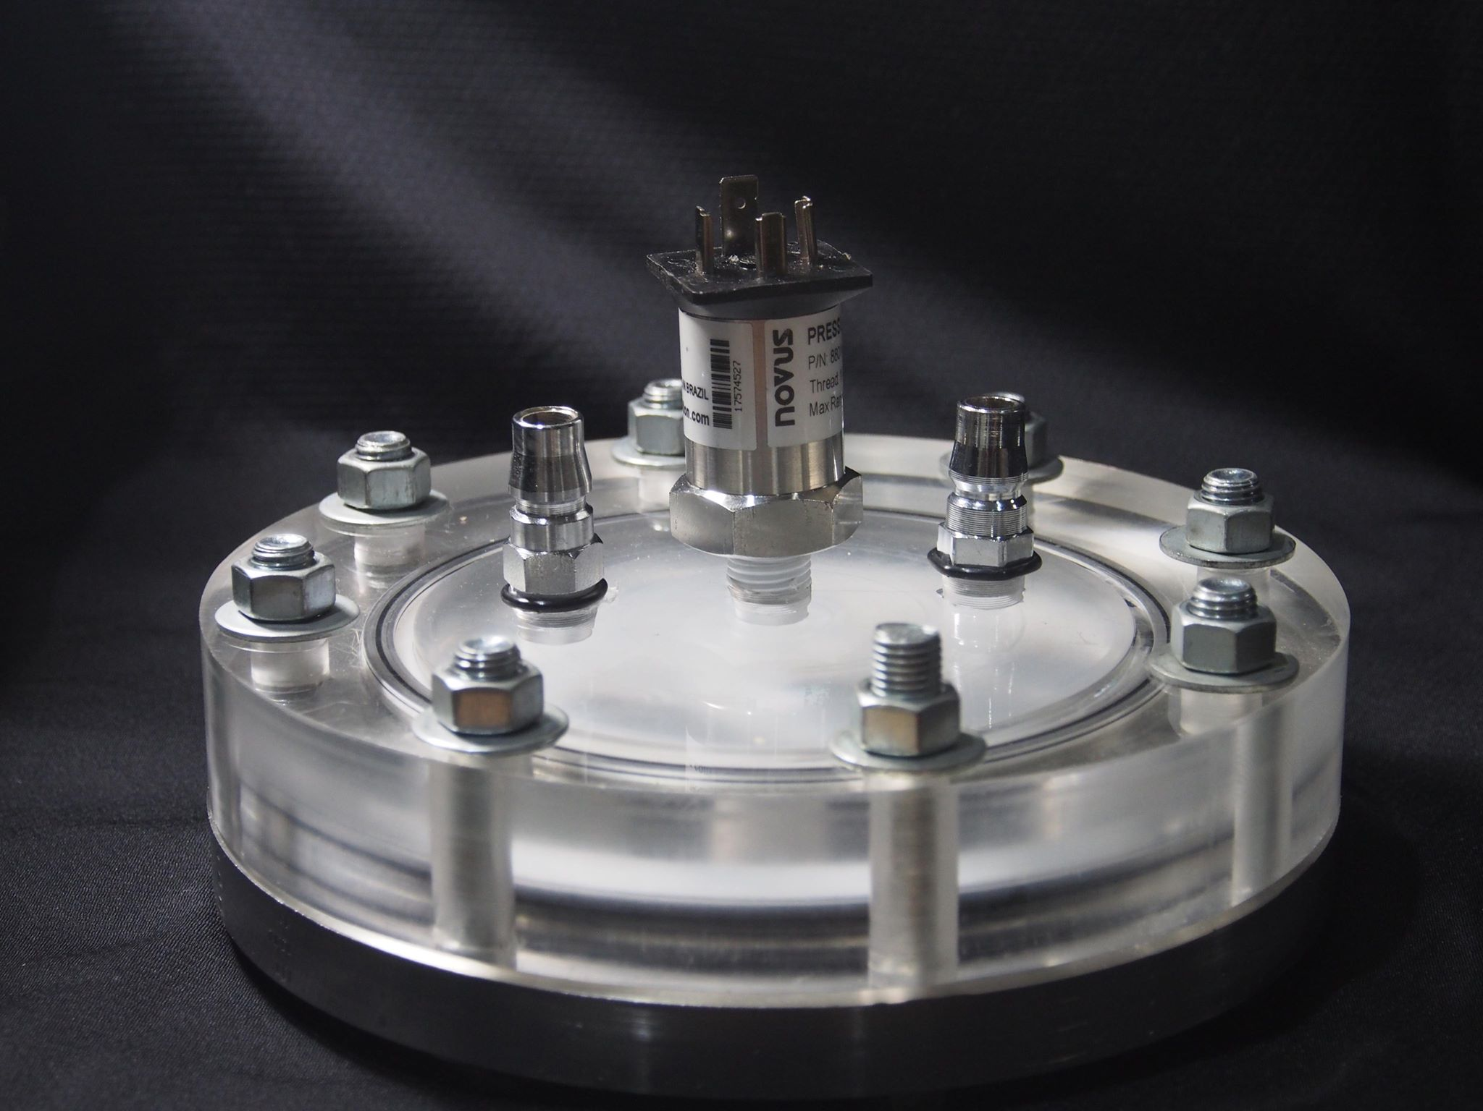

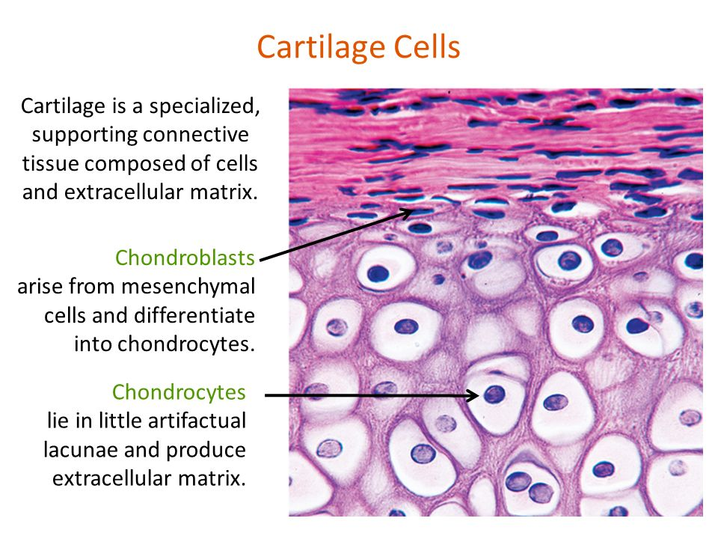
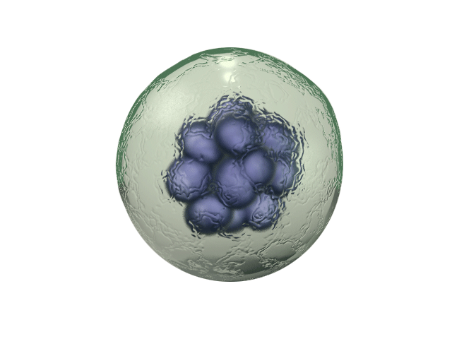
Our
Exercise cartilage cells with
Cell with our device
Forces
Make cell
Hydrostatic Pressure
Normal cell
Innovation
Flexible
Pressure
Film
Withstand load
Cartilage Cell
Extracellular Matrix
Patient’s Cells
Media
Healthy
Collagen type II
Aggrecan
Cell

Slide 12
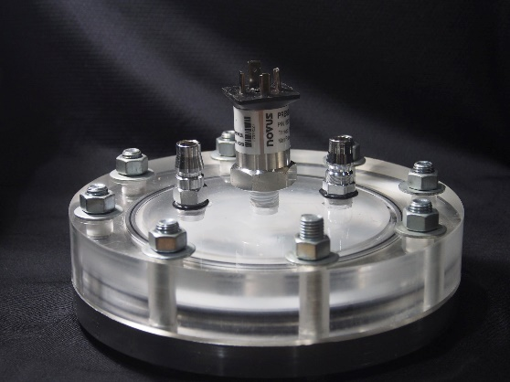
Treatment for Each Stage
Early Stage
Final Stage
Intermediate stage
Cell Therapy with Our Innovation
Taking Pills
Knee Replacement
420 USD/year
10,000-15,000 USD/treatment
1,000 USD/knee
Small surgery or Injection
Only ease pain
Invasive open surgery
Continuously taking pills for long period
Metal implant
Patient’s cell

Slide 13

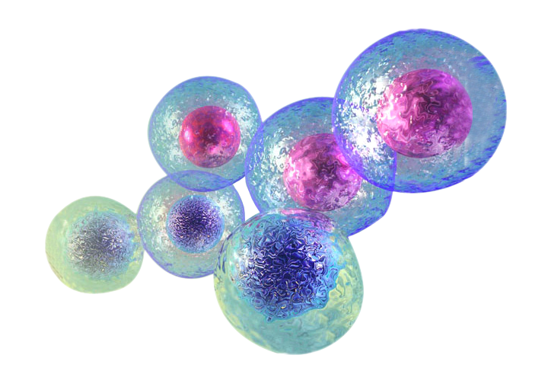
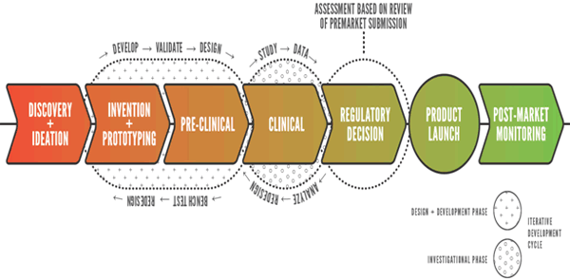
Where are we now?
Where will we be in the future?
In the future,
Discovery
Invention
Discovery
Invention
+
+
Pre-Clinical
Clinical
+
+
Pre-Clinical
Clinical
Ideation
Prototyping
Ideation
Prototyping
We are going to

Slide 14
1
2
3
4
Culture Stem Cells with Our Innovation
Collecting Patient Cell
Culturing Cell
Creating Tissue
Attach To Patient

Slide 15








Collaborator
Hospital
Resource provided by Siriraj Hospital
(The Biggest National hospital in Thailand)
Partners
Partners
Resource provided by
Siriraj Hospital
(The Biggest National hospital in Thailand)
Patient
Cell therapy company

